Slide 1
unit 3.0
Wood

Slide 2
Objectives
Correctly identify the differences between hardwood and softwood trees
Discuss the processing of the wood from tree to board in sequential order
Recognize standard molding patterns
Name and describe common lumber defects
Describe how the production, grading, and sale of hardwood and softwood lumber differ

Slide 3
Objectives (continued)
Calculate board feet
Identify different types of grain and explain how they affect the appearance of wood
Describe wood movement and how it affects woodworking practices
Identify various woods and their individual characteristics
Identify sources for acquiring wood

Slide 4
Introduction
Trees are a source of abundant materials
Virtually every part of the tree can be turned to our use
Trees provide the materials used to build and furnish our homes

Slide 5
Hardwoods and Softwoods
Trees can be divided into two main categories:
Hardwoods (deciduous)
Softwoods (coniferous)
Parts of a tree
Pith
Annual rings
Bark
Cambium: has two parts—phloem and xylem

Slide 6
Hardwoods and Softwoods (continued)
Parts of a tree (continued)
Sapwood
Heartwood
Medullary rays

Slide 7
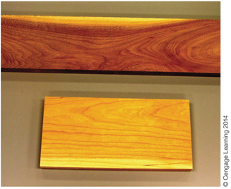
sapwood
heartwood
heartwood
sapwood
Figure 9-3 Both walnut (top) and cherry (bottom) exhibit a striking difference in color between their heartwood and sapwood.

Slide 8
Hardwoods and Softwoods (continued)
Foresters and loggers select trees to be cut for lumber
Trees are cut down and their limbs are removed
Trunks are bundled together and transported to a sawmill for processing
At the mill, logs are sorted by species

Slide 9
Hardwoods and Softwoods (continued)
Best logs are set aside to be processed into cabinet-grade veneer
Bark is stripped off by a debarking machine
Logs go through metal detector to sort out logs containing metal
Majority of logs that are processed into lumber are squared up
Squared-up log is called cant

Slide 10
Hardwoods and Softwoods (continued)
Cants are sawn into boards
Edges of boards are trimmed to achieve uniform width; boards are cut to length
Boards go to the grader to be sorted
After grading, boards are packaged for drying

Slide 11
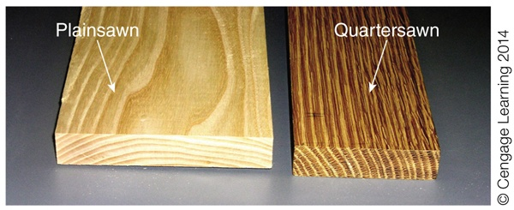
Figure 9-11 Plainsawn and quartersawn lumber have a very different appearance.

Slide 12
Hardwoods and Softwoods (continued)
After drying, we have roughsawn lumber
Depending on the tools a shop has, it may purchase roughsawn lumber
Lumber not sold as roughsawn is surfaced
Most of the lumber purchased by cabinetmakers is surfaced two sides (S2S)

Slide 13
Moldings
Wood pieces with shaped edges
Used cover transitions between surfaces
Act as decorative elements
Moldings are used in home construction
Decorate the edges of doors and windows
Floor/wall and wall/ceiling intersections
Purchased by the type, size, grade, and length

Slide 14
Lumber Defects
Common natural defects
Knot
Blue stain
Pitch pocket
Bark pocket

Slide 15
Lumber Defects (continued)
Defects that occur in milling and drying
Warp
Bow
Crook
Cup
Twist
Kink
Wane

Slide 16
Lumber Defects (continued)
Defects that occur in milling and drying (continued)
Split
Check
Shake
Case hardening
Honeycombing

Slide 17
Lumber Grades
Softwood grades
Standards set by associations of lumber producers
Must conform to U.S. Department of Commerce American Lumber Standards
American Softwood Lumber Standard PS 20-70
Based on structural integrity of a board
Two broad categories
Construction
Remanufacture

Slide 18
Lumber Grades (continued)
Hardwood grades
Standards established by National Hardwood Lumber Association (NHLA)
Based on the amount of clear wood that can be cut from each board
Standard grades form the framework by which all American hardwoods are traded
Both sides of the board must meet the minimum requirements

Slide 19
Lumber Grades (continued)
Softwood lumber
Sold in standard thicknesses, widths, and lengths
Ordered by its nominal size
Sold by the individual piece

Slide 20
Lumber Grades (continued)
Hardwood lumber
Estimated and sold by the board foot, rather than by the piece
Widths and lengths are not standardized
Thickness of the piece is indicated by the quarter of an inch, and not in whole inches

Slide 21
Lumber Grades (continued)
Strength of any wooden component is determined by its grain and how that grain is oriented on the furniture component
Also affects stability of the material, gluing properties, and finishing
Types of grain
End grain, longitudinal grain, edge grain, face grain, radial grain, and tangential grain

Slide 22
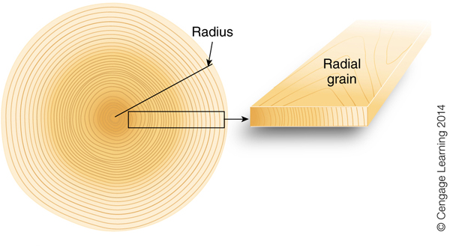
Figure 9-27 A board exhibiting radial grain on its face was cut along a radius running from the center of the tree outward.

Slide 23
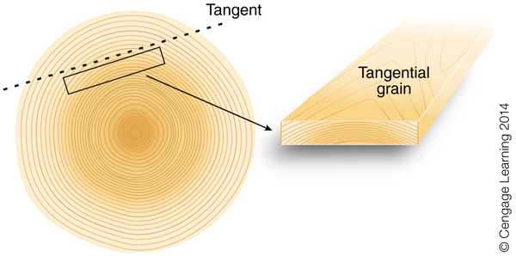
Figure 9-29 A board showing tangential grain on its face was cut tangent to the growth rings of the tree.

Slide 24
Lumber Grades (continued)
Wood movement
Wood is not a static material
Expands and contracts in response to changes in relative humidity
As we build furniture, we have to allow for this movement
The way wood moves is directly related to its grain
Greatest amount of movement takes place tangent to the grain

Slide 25
Lumber Grades (continued)
Home centers
Retail lumber stores
Hardwood mills
Can have trees of your own cut and milled by a portable band saw mill

Slide 26
Lumber Grades (continued)
Structures slated for demolition
Local road crews
Power companies
Mail order and online

Slide 27
Summary
Wood is a beautiful yet complex material
Understanding how wood grew and was milled and seasoned gives us vital tools for working with it successfully
Appearance of wood and its behavior relative to the surrounding environment are largely determined by the roles the wood played in the original tree

