Slide 1
Tool Identification

Slide 2
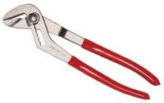
Identify this Tool:
Channel Lock Pliers

Slide 3
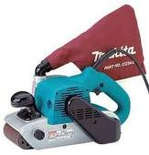
Identify this Tool:
Belt Sander

Slide 4
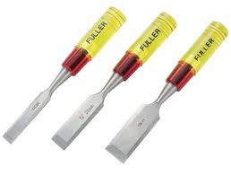
Identify this Tool:
Chisel

Slide 5
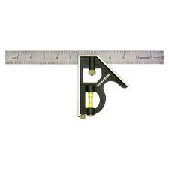
Identify this Tool:
Combination Square

Slide 6
Identify this Tool:
Cordless Drill

Slide 7
Identify this Tool:
Diagonal Cutters

Slide 8
Identify this Tool:
Files

Slide 9
Identify this Tool:
Framing Square

Slide 10
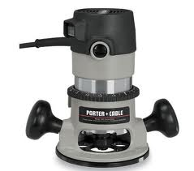
Identify this Tool:
Hand Router

Slide 11
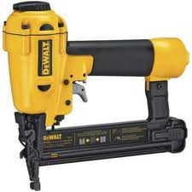
Identify this Tool:
Nail Gun

Slide 12
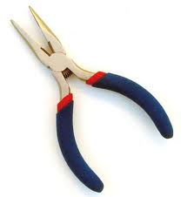
Identify this Tool:
Needle Nose Pliers

Slide 13
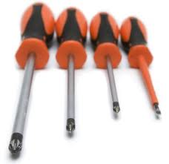
Identify this Tool:
Phillips Screw Driver

Slide 14
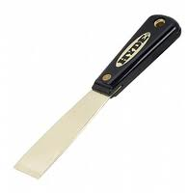
Identify this Tool:
Putty Knife

Slide 15
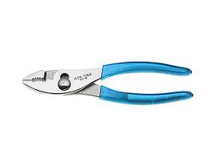
Identify this Tool:
Slip Joint Pliers

Slide 16
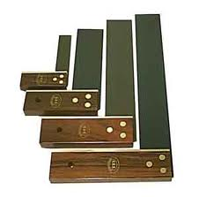
Identify this Tool:
Try Square

Slide 17
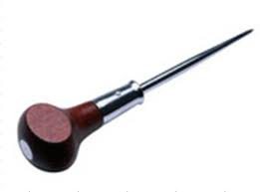
Identify this Tool:
Awl

Slide 18
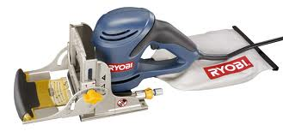
Identify this Tool:
Biscuit Joiner

Slide 19
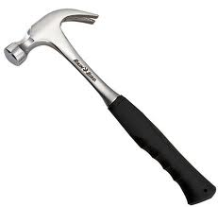
Identify this Tool:
Claw Hammer

Slide 20
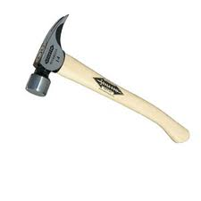
Identify this Tool:
Framing Hammer

Slide 21
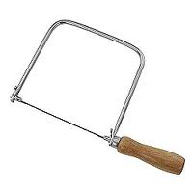
Identify this Tool:
Coping Saw

Slide 22
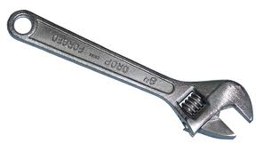
Identify this Tool:
Adjustable Wrench

Slide 23
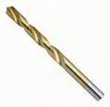
Identify this Tool:
Twist Drill Bit

Slide 24
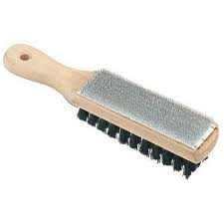
Identify this Tool:
File Card

Slide 25
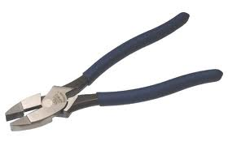
Identify this Tool:
Linesman Pliers

Slide 26
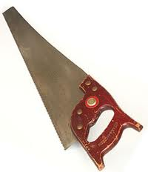
Identify this Tool:
Small teeth
Crosscut Saw

Slide 27
Identify this Tool:
Big teeth
Rip Saw

Slide 28
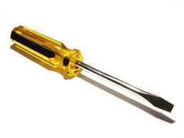
Identify this Tool:
Flat Head Screwdriver

Slide 29
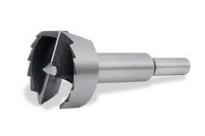
Identify this Tool:
Forstner Bit

Slide 30
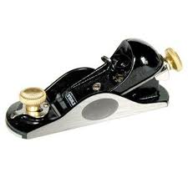
Identify this Tool:
Block Plane

Slide 31
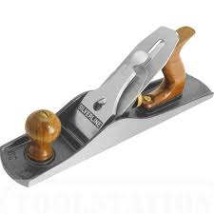
Identify this Tool:
Jack Plane

Slide 32
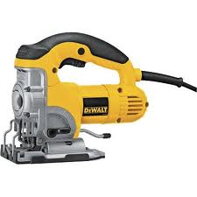
Identify this Tool:
Jig Saw

Slide 33
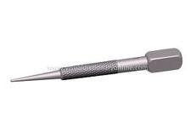
Identify this Tool:
Nail Set

Slide 34
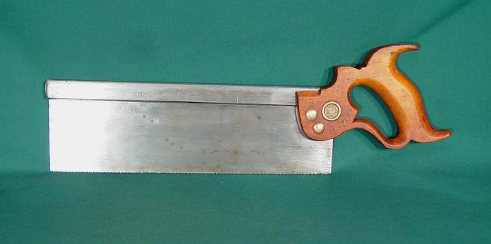
Identify this Tool:
Back Saw

Slide 35
Identify this Tool:
Counter Sink Bit

Slide 36
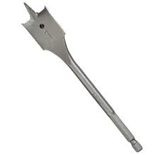
Identify this Tool:
Spade Bit

Slide 37
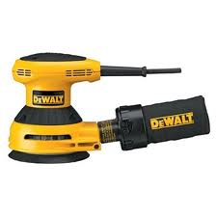
Identify this Tool:
Palm Sander

Slide 38
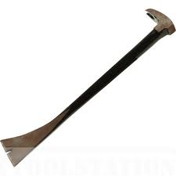
Identify this Tool:
Pry Bar

Slide 39
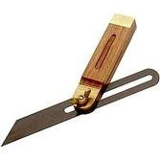
Identify this Tool:
Sliding T-Bevel

Slide 40
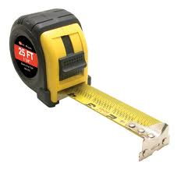
Identify this Tool:
Tape Measure

Slide 41
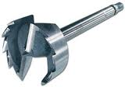
Identify this Tool:
Multi Spur Bit

Slide 42
Power Machine ID

Slide 43
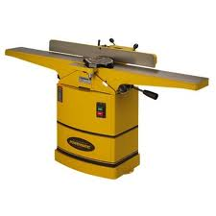
Identify this Machine:
Jointer

Slide 44
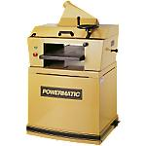
Identify this Machine:
Planer

Slide 45
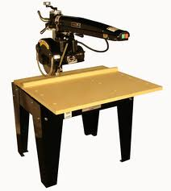
Identify this Machine:
Radial Arm Saw

Slide 46
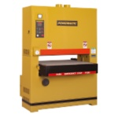
Identify this Machine:
Wide Belt Sander

Slide 47
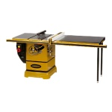
Identify this Machine:
Table Saw

Slide 48
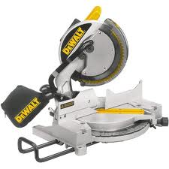
Identify this Machine:
Chop/Miter Saw

Slide 49
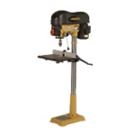
Identify this Machine:
Drill Press

Slide 50
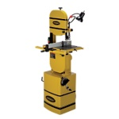
Identify this Machine:
Band Saw

Slide 51
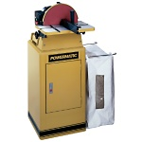
Identify this Machine:
Disc Sander

Slide 52
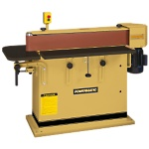
Identify this Machine:
Horizontal Belt Sander

Slide 53
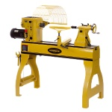
Identify this Machine:
Lathe

Slide 54
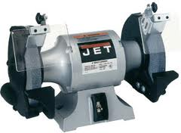
Identify this Machine:
Bench Grinder

Slide 55
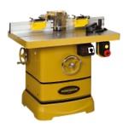
Identify this Machine:
Shaper

Slide 56
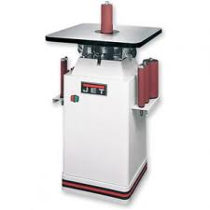
Identify this Machine:
Oscillating Spindle Sander

